Slide 1
PSAP and Gaucher Disease
By Mitchell Coplan
http://www.clipartbest.com/garbage-truck-clip-art

Slide 2
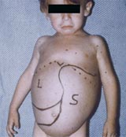
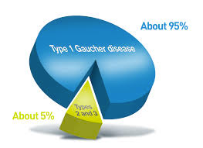
What is Gaucher Disease?
http://www.vpriv.com/about-vpriv/what-is-type-1-gaucher-disease.php
http://www.gauchercare.com/en/healthcare.aspx
http://www.vpriv.com/about-gaucher-disease/

Slide 3
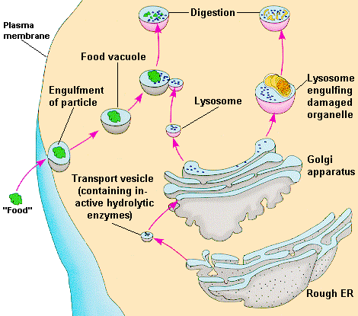
What causes these phenotypes?
Lysosomal storage disease
Cells can’t break down glucocerebrosides
http://wiki.pingry.org/u/ap-biology/index.php/Lysosomes
http://lipidlibrary.aocs.org/Lipids/whatlip/index.htm

Slide 4
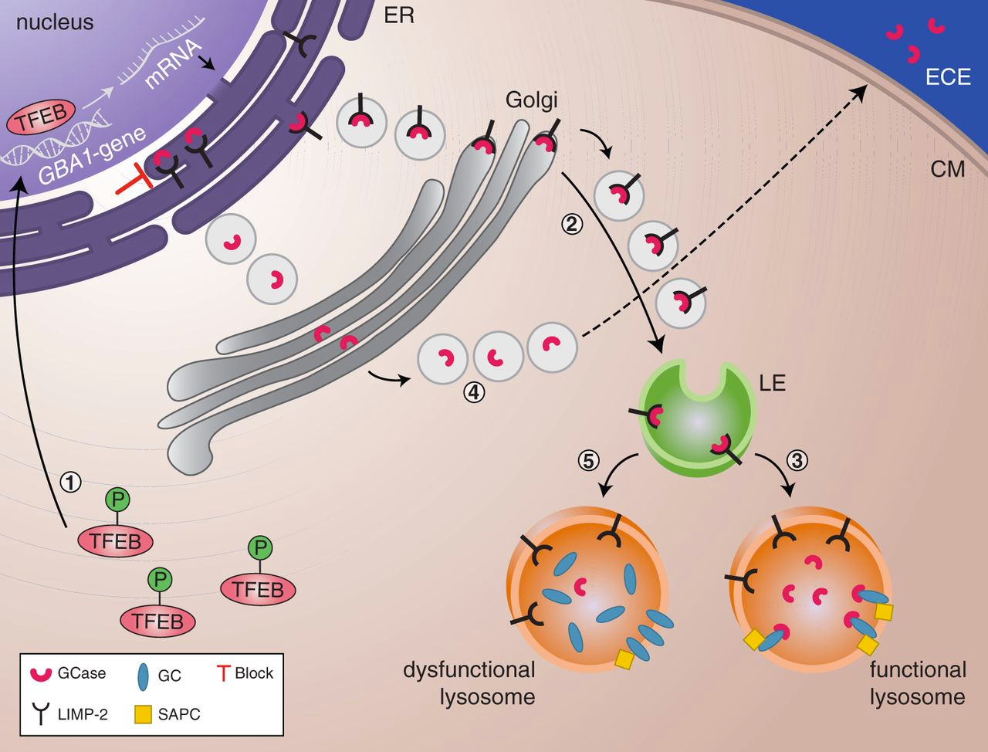
How are glucocerebrosides(GC) normally broken down?
http://brain.oxfordjournals.org/content/early/2014/02/14/brain.awu002

Slide 5
What gene(s) is mutated in Gaucher Disease?
GBA (GCase) and PSAP (SAPC)

Slide 6
PSAP is mutated

Slide 7
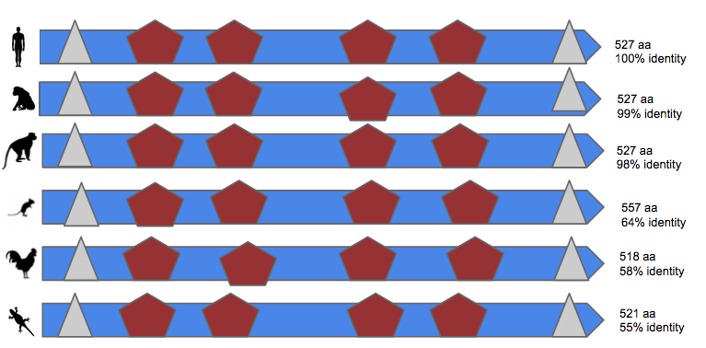
How well conserved is the protein?
The proteins domains are highly conserved

Slide 8
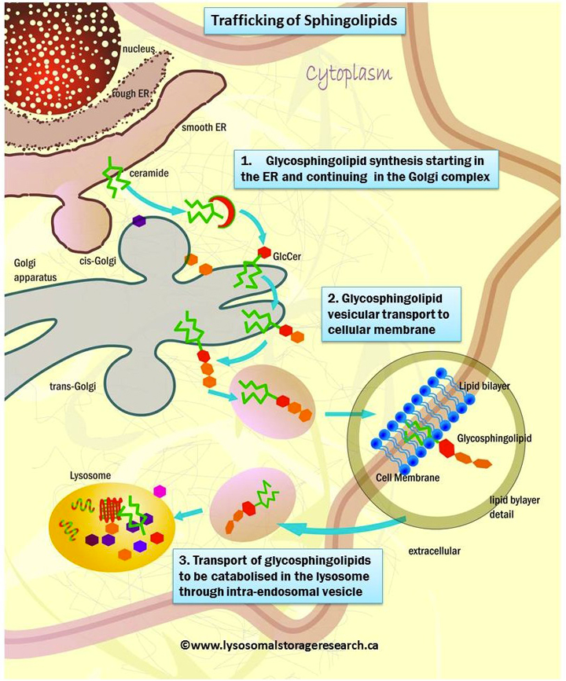
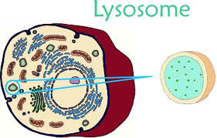
Where and how does PSAP function?
Cellular Components
Biological Processes
Molecular Function
sphingolipid metabolic process

Slide 9
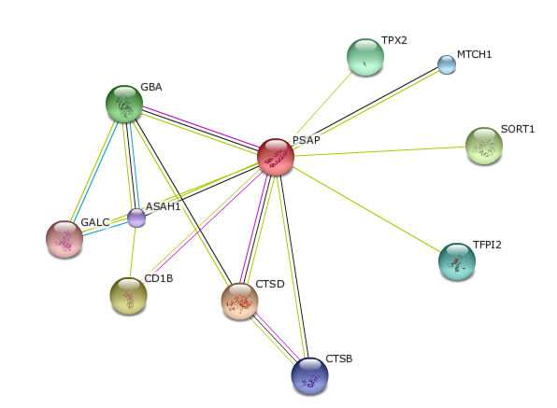
PSAP and GBA are binding partners

Slide 10
Genotype-phenotype association?
Exact same GBA mutation
What is responsible for the differences in clinical manifestations?

Slide 11
Hypothesize that variations in PSAP contribute to the phenotypic variability in GD patients with same GBA mutations
PSAP?

Slide 12
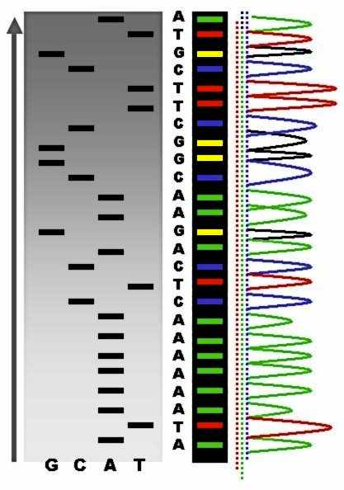
Aim 1: To Identify PSAP variants that are associated with patients who have the same GBA mutation, but do not exhibit the same symptoms.
Same GBA
Different PSAP & symptoms
Hypothesis: There will be individuals with variations in PSAP and symptoms but have the same GBA mutation.
http://en.wikipedia.org/wiki/DNA_sequencing

Slide 13
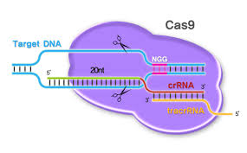
Aim 2: Examine the effects of overexpression of wild type PSAP in mice with the same GBA mutation.
Healthier?
Hypothesis: Changing the expression of PSAP will result in a phenotypic change in mice with GBA mutations.
http://pnabio.com/products/CRISPR_Cas9.htm
http://www.everymantri.com/everyman_triathlon/2011/03/exercise-can-slow-and-even-prevent-aging-a-new-study-confirms.html

Slide 14
Aim 3:Compare tissue specific levels of PSAP expression in GD patients.
liver tissue
Differences in expression?
Hypothesis: Tissues that result in differences in symptoms will have irregular PSAP expression

Slide 15
Payoff?
PSAP is a factor in disease symptoms
http://www.vpriv.com/starting-treatment/intro-to-ert.php
http://pixgood.com/healthy-man-clipart.html

Slide 16
Questions?
http://cliparts.co/people-animation

Slide 17
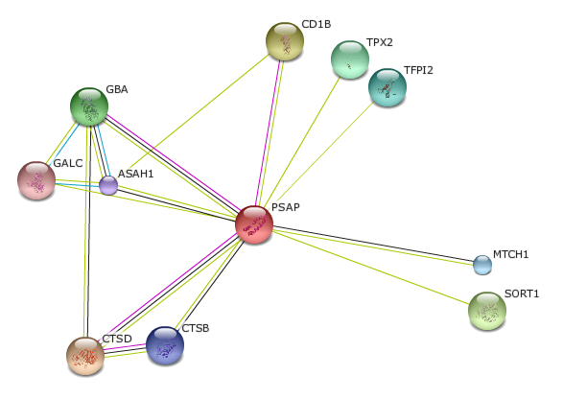
This slide is not part of my presentation
Hydrolysis of lipids
Protein transport
Intracellular protein degration

